Slide 1
MATH2010 Probability BASICs
Le DUY DUNG
College of Engineering and Computer Science

Slide 2
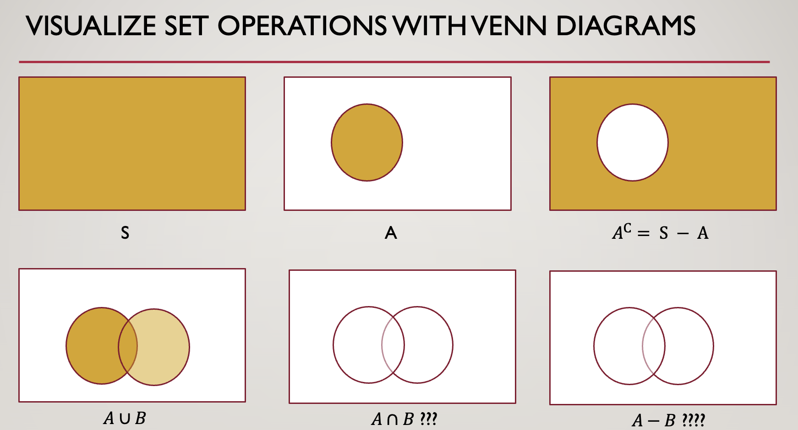
From LECTURE 1

Slide 3
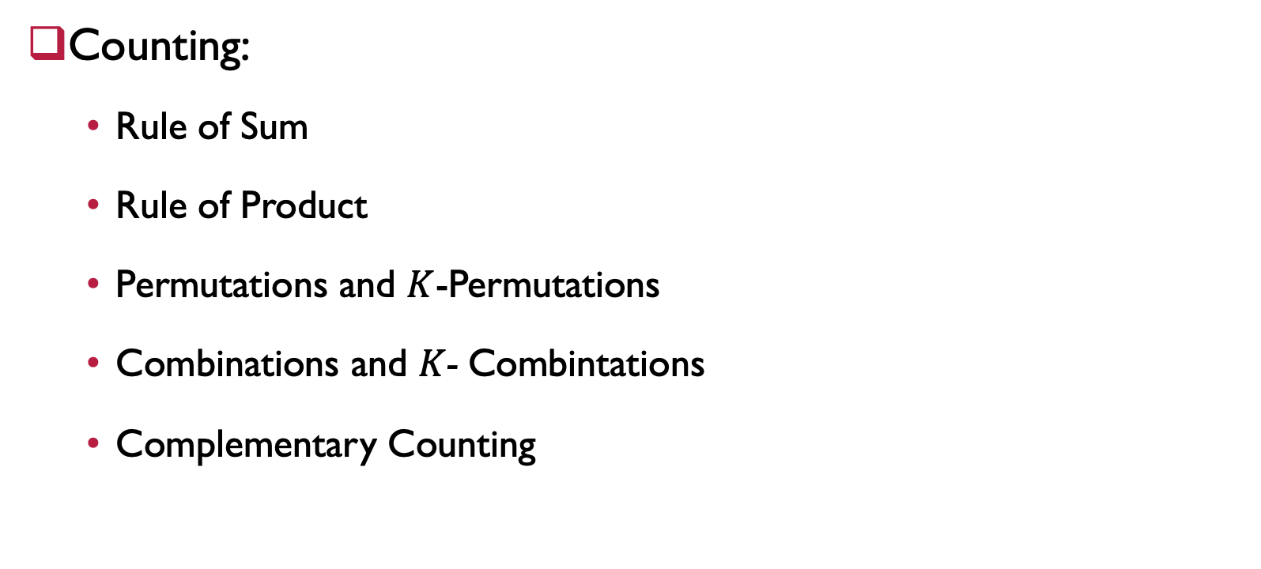
From LECTURE 1
Counting:
Rule of Sum
Rule of Product
Permutations and $K$-Permutations
Combinations and $K$- Combintations
Complementary Counting

Slide 4

Probability
Source: https://www.123rf.com/

Slide 5
LEARNING GOALS
Know the definitions of sample space, event and probability function.
Be able to organize a scenario with randomness into an experiment and sample space.
Be able to make basic computations using a probability function.

Slide 6

Sample SPACE
Definition: The sample space is the set $Ω$ of all possible outcomes of an experiment.
List of all possible outcomes $Ω$:
Mutually exclusive
Collectively exhaustive
At the “right” granularity

Slide 7


Sample SPACE EXAMPLES
Definition: The sample space is the set $Ω$ of all possible outcomes of an experiment.
Example.
Find the sample space of...
1. a single coin flip.
2. two coin flips.
3. the roll of a fair 6-sided die
Notes:
Answer:
1. The sample space of a single coin flip is: $Ω = \{H, T\}$ (heads or tails).
2. The sample space of two coin flips is:$Ω = \{HH, HT, TH, TT\}$.
3. The sample space of the roll of a 6-sided die is: $Ω = \{1, 2, 3, 4, 5, 6\}$.

Slide 8
Sample SPACE EXAMPLES
Definition: The sample space is the set $Ω$ of all possible outcomes of an experiment.
Example.
Find the sample space of...
1. a single coin flip.
2. two coin flips.
3. the roll of a fair 6-sided die
Notes:
Answer:
1. The sample space of a single coin flip is: $Ω = \{H, T\}$ (heads or tails).
2. The sample space of two coin flips is:$Ω = \{HH, HT, TH, TT\}$.
3. The sample space of the roll of a 6-sided die is: $Ω = \{1, 2, 3, 4, 5, 6\}$.

Slide 9
Sample SPACE EXAMPLES
Definition: The sample space is the set $Ω$ of all possible outcomes of an experiment.
Example.
Find the sample space of the rolling two fair 6-sided dice
Notes:
Answer:
1. The sample space of a single coin flip is: $Ω = \{H, T\}$ (heads or tails).
2. The sample space of two coin flips is:$Ω = \{HH, HT, TH, TT\}$.
3. The sample space of the roll of a 6-sided die is: $Ω = \{1, 2, 3, 4, 5, 6\}$.

Slide 10
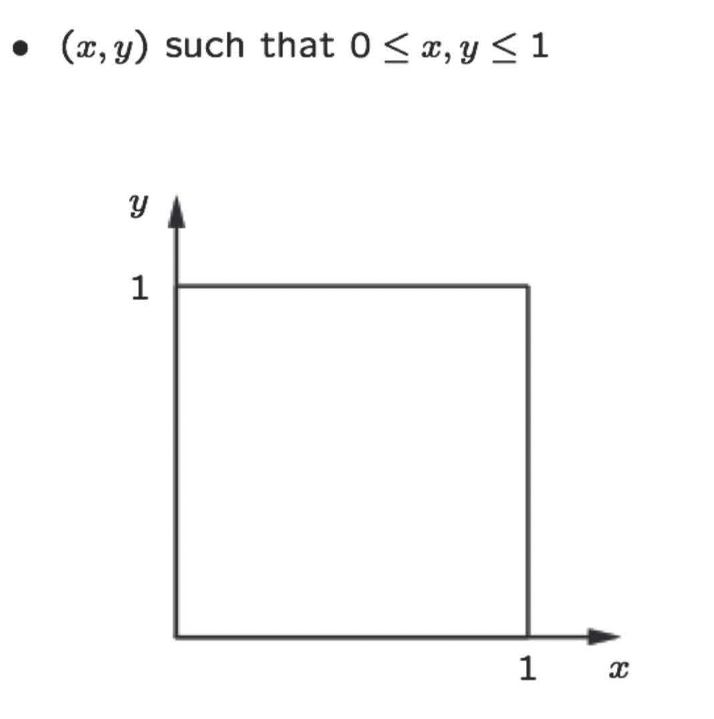
Sample SPACE EXAMPLES - COnTINUOUS
Definition: The sample space is the set $Ω$ of all possible outcomes of an experiment.
Example.
Throwing a dart in to a target:
Notes:
Answer:
1. The sample space of a single coin flip is: $Ω = \{H, T\}$ (heads or tails).
2. The sample space of two coin flips is:$Ω = \{HH, HT, TH, TT\}$.
3. The sample space of the roll of a 6-sided die is: $Ω = \{1, 2, 3, 4, 5, 6\}$.

Slide 11
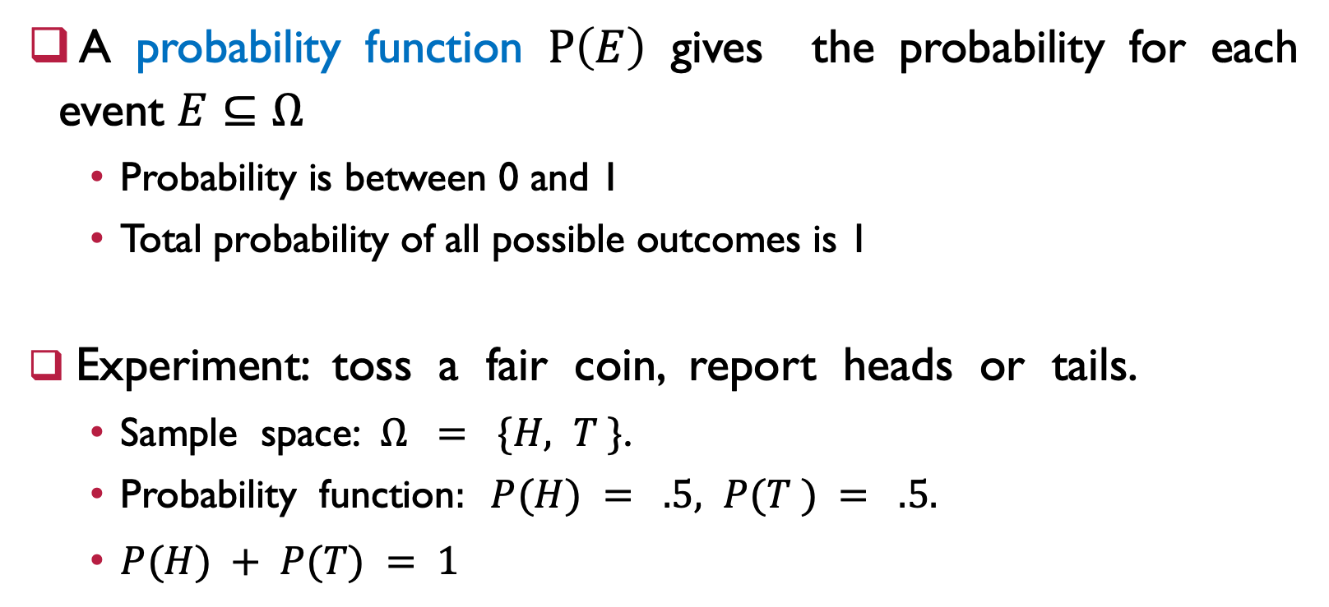
Probability Function
A probability function $P\left(E\right)$ gives the probability for each event $E⊆Ω$
Probability is between 0 and 1
Total probability of all possible outcomes is 1
Experiment: toss a fair coin, report heads or tails.
Sample space: $Ω = \{H, T \}$.
Probability function$: P(H) = .5, P(T ) = .5.$
$P(H) + P(T) = 1$

Slide 12
EVENT
Definition: An event is any subset 𝐸 ⊆ Ω.
Example.
List out the set of outcomes for the following events:
1. Getting at least one head in two coin flips
2. Rolling an even number on a fair 6-sided die

Slide 13
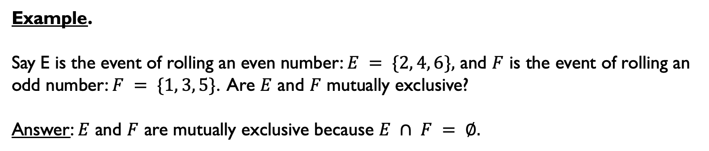
MUTUAL EXCLUSION
Definition: Events 𝐸 and 𝐹 are mutually exclusive if 𝐸 ∩ 𝐹 = ∅. (i.e. they can’t
simultaneously happen).
Example.
Say E is the event of rolling an even number: $E = \{2, 4, 6\},$ and $F$ is the event of rolling an odd number: $F = \{1, 3, 5\}$. Are $E$ and $F$ mutually exclusive?
Answer: $E$ and $F$ are mutually exclusive because $E ∩ F = ∅.$

Slide 14
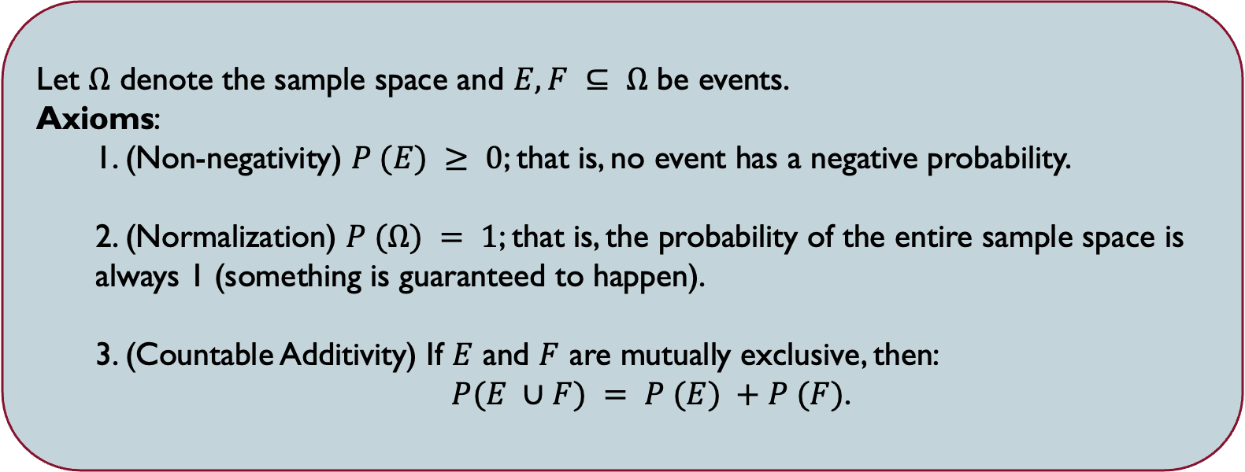
AXIOMS of PROBABILITY
Let $Ω$ denote the sample space and $E, F ⊆ Ω$ be events.
Axioms:
1. (Non-negativity) $P (E) ≥ 0$; that is, no event has a negative probability.
2. (Normalization) $P (Ω) = 1$; that is, the probability of the entire sample space is always 1 (something is guaranteed to happen).
3. (Countable Additivity) If $E$ and $F$ are mutually exclusive, then:
$P(E ∪F) = P (E) +P (F)$.

Slide 15
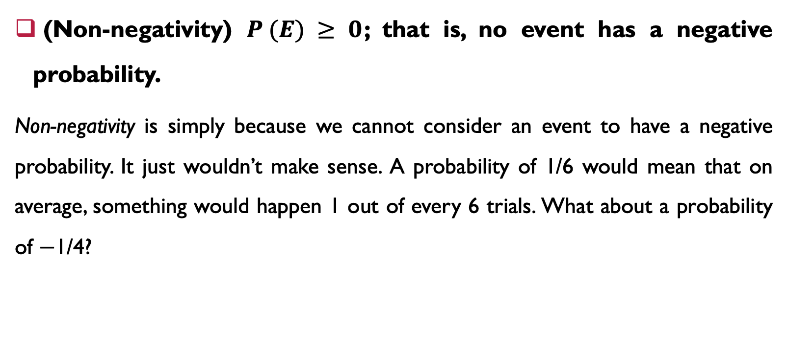
Explanation of axioms
(Non-negativity) $P (E) ≥ 0$; that is, no event has a negative probability.
Non-negativity is simply because we cannot consider an event to have a negative probability. It just wouldn’t make sense. A probability of 1/6 would mean that on average, something would happen 1 out of every 6 trials. What about a probability of −1/4?

Slide 16
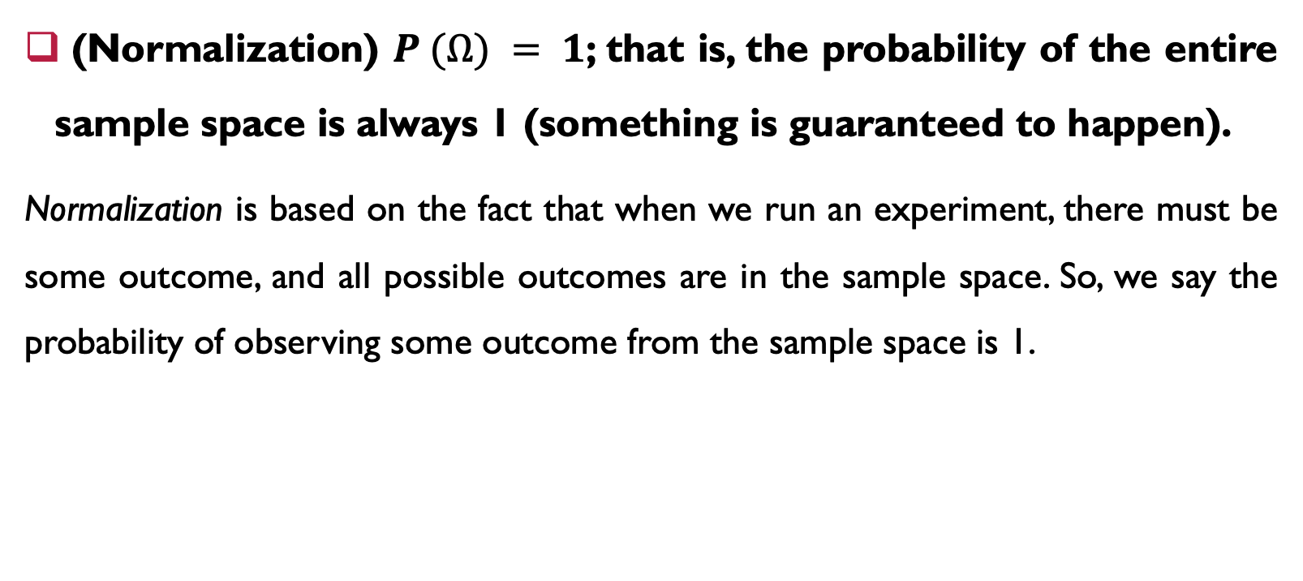
Explanation of axioms
(Normalization) $P (Ω) = 1$; that is, the probability of the entire sample space is always 1 (something is guaranteed to happen).
Normalization is based on the fact that when we run an experiment, there must be some outcome, and all possible outcomes are in the sample space. So, we say the probability of observing some outcome from the sample space is 1.

Slide 17
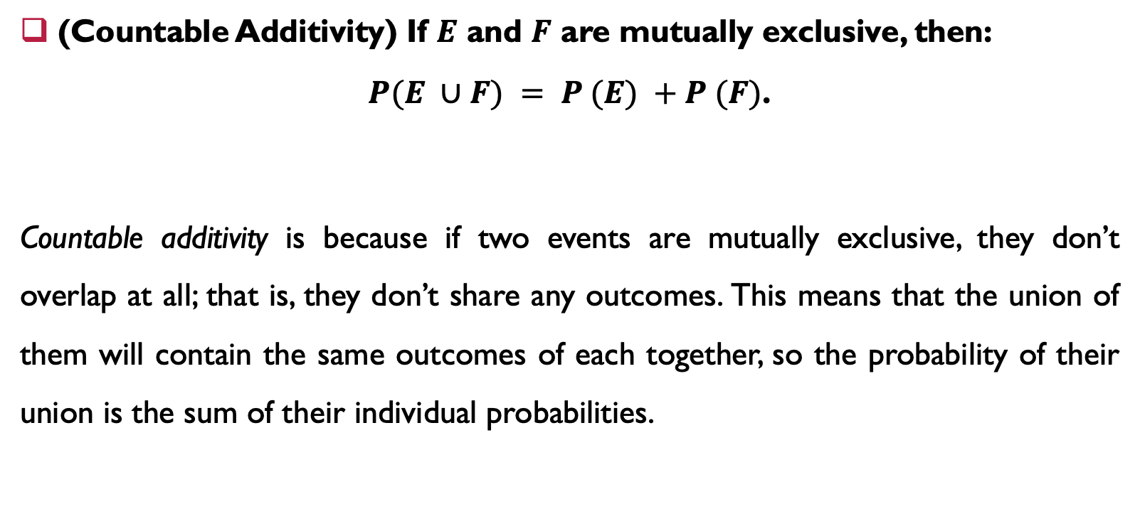
Explanation of axioms
(Countable Additivity) If $E$ and $F$ are mutually exclusive, then:
$P(E ∪F) = P (E) +P (F)$.
Countable additivity is because if two events are mutually exclusive, they don’t overlap at all; that is, they don’t share any outcomes. This means that the union of them will contain the same outcomes of each together, so the probability of their union is the sum of their individual probabilities.

Slide 18
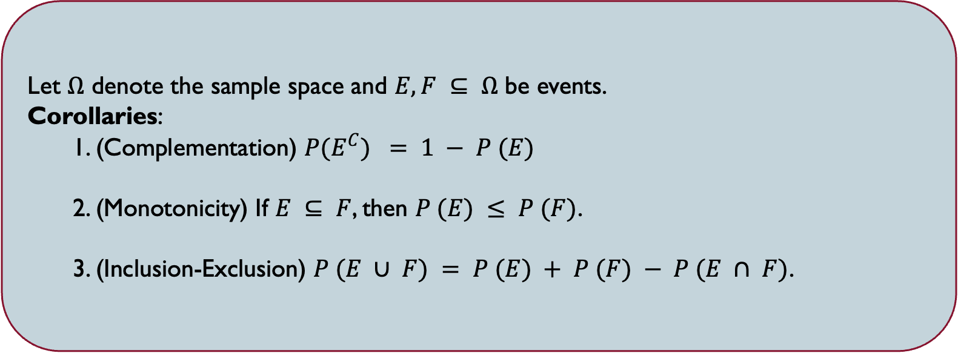
AXIOMS of PROBABILITY
Let $Ω$ denote the sample space and $E, F ⊆ Ω$ be events.
Corollaries:
1. (Complementation) $P(E^{C}) = 1 − P (E)$
2. (Monotonicity) If $E ⊆ F$, then $P (E) ≤ P (F)$.
3. (Inclusion-Exclusion) $P (E ∪ F) = P (E) + P (F) − P (E ∩ F)$.

Slide 19
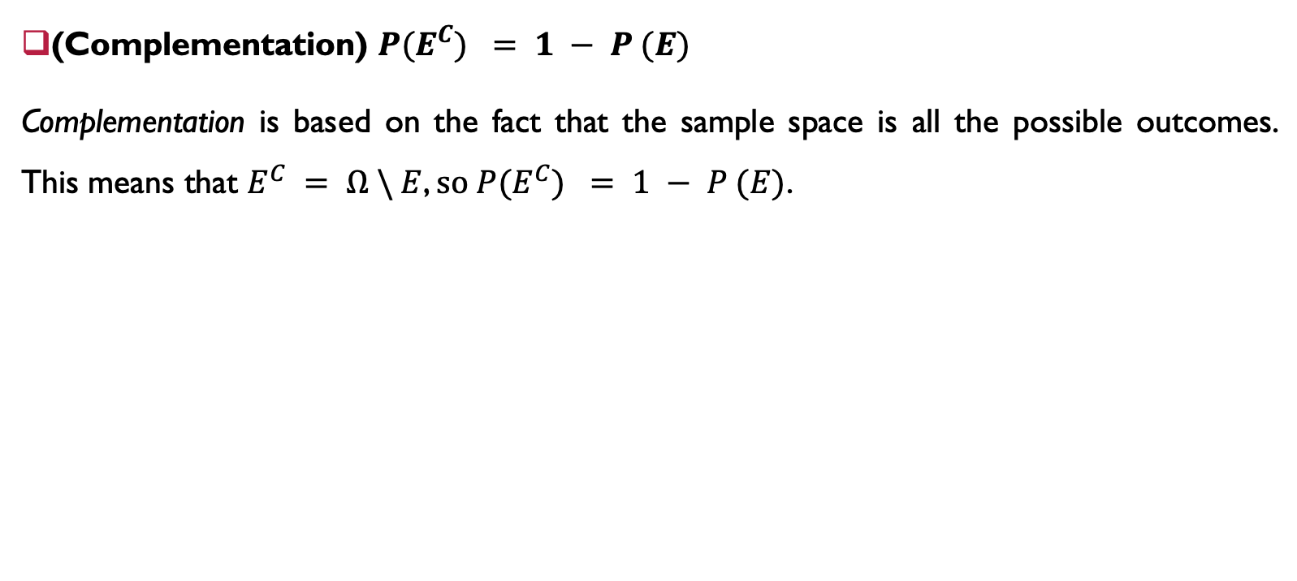
Explanation of Corollaries
(Complementation) $P(E^{C}) = 1 − P (E)$
Complementation is based on the fact that the sample space is all the possible outcomes. This means that $E^{C} = Ω \backslash E$, $so P(E^{C}) = 1 − P (E)$.

Slide 20
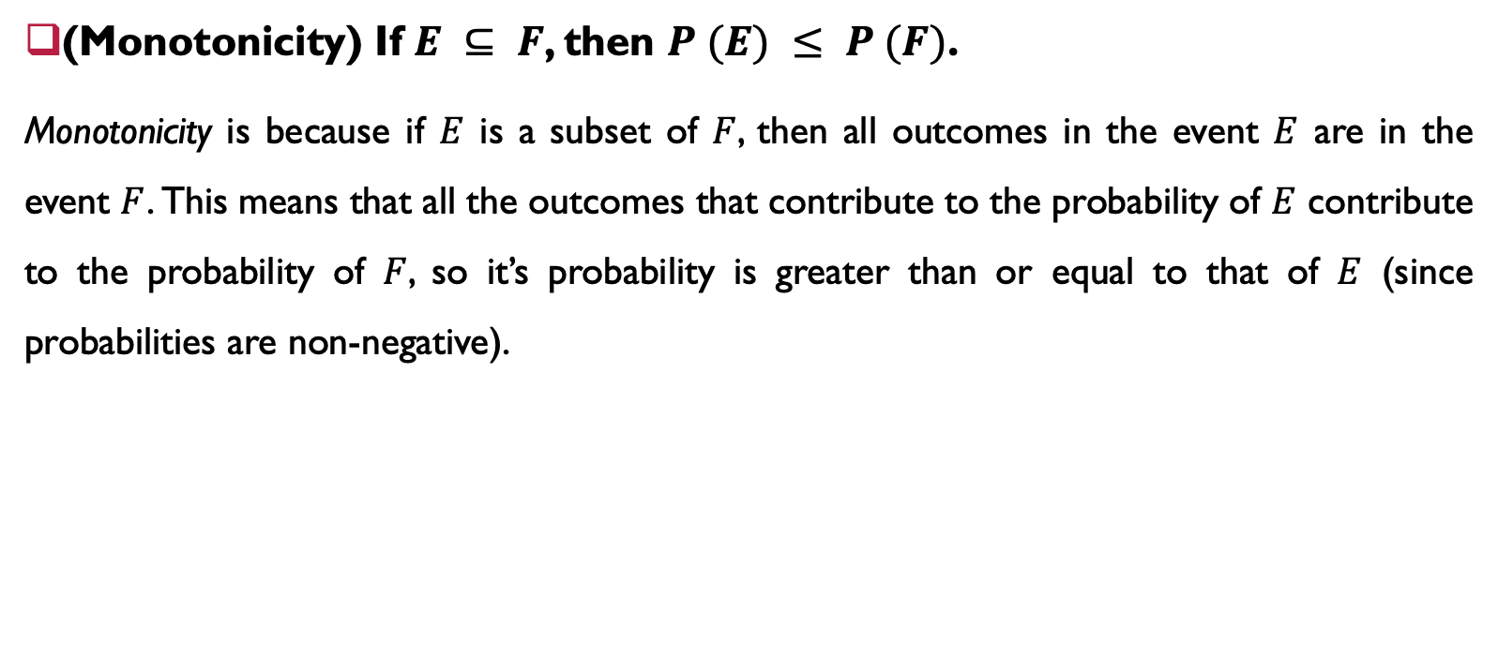
Explanation of Corollaries
(Monotonicity) If $E ⊆ F$, then $P (E) ≤ P (F)$.
Monotonicity is because if $E$ is a subset of $F$, then all outcomes in the event $E$ are in the event $F$. This means that all the outcomes that contribute to the probability of $E$ contribute to the probability of $F$, so it’s probability is greater than or equal to that of $E$ (since probabilities are non-negative).

Slide 21
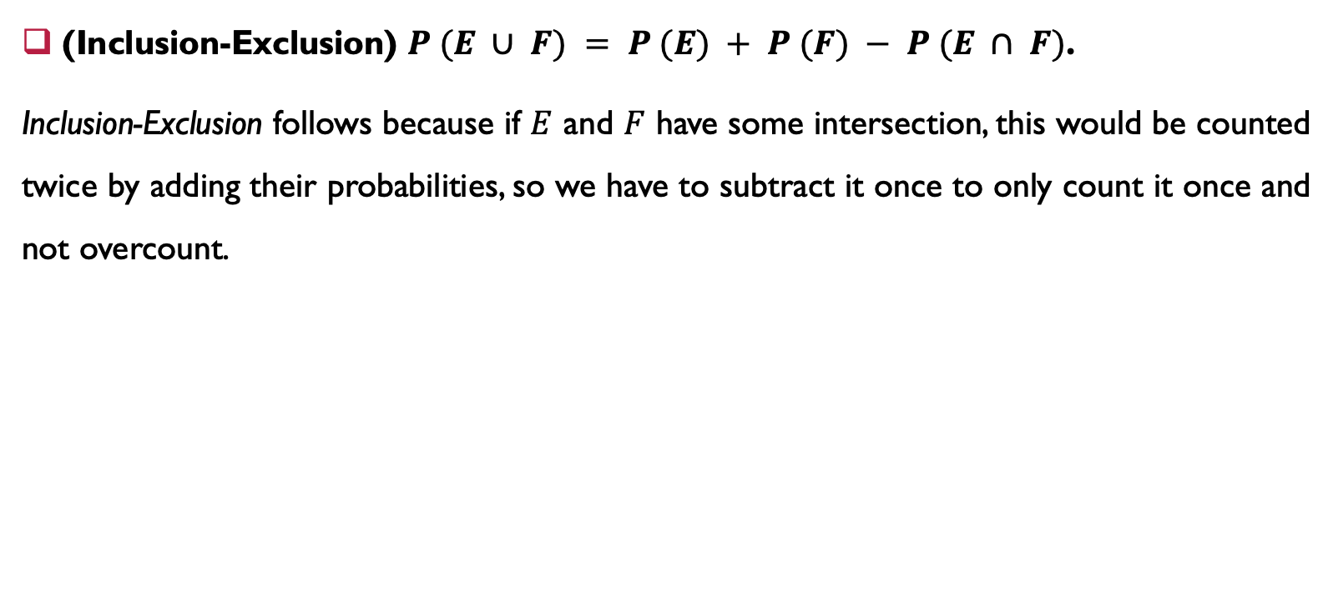
Explanation of Corollaries
(Inclusion-Exclusion) $P (E ∪ F) = P (E) + P (F) − P (E ∩ F)$.
Inclusion-Exclusion follows because if $E$ and $F$ have some intersection, this would be counted twice by adding their probabilities, so we have to subtract it once to only count it once and not overcount.

Slide 22
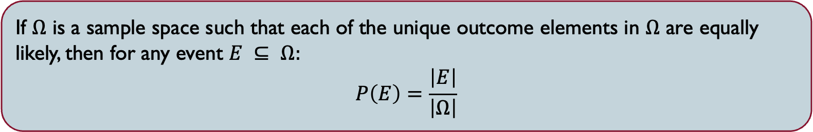
SAMPLE SPACEs HAVING EQUALLY LIKELY OUTCOMES
If $Ω$ is a sample space such that each of the unique outcome elements in $Ω$ are equally likely, then for any event $E ⊆ Ω:$
$$P\left(E\right)=\frac{\left|E\right|}{\left|Ω\right|}$$

Slide 23
SAMPLE SPACEs HAVING EQUALLY LIKELY OUTCOMES
Question 1: If there are 5 people named A, B, C, D, and E, and they are randomly arranged in a row (with each ordering equally likely), what is the probability that A and B are placed next to each other?

Slide 24
SAMPLE SPACEs HAVING EQUALLY LIKELY OUTCOMES
Question 2: Suppose I draw 4 cards from a standard 52-card deck. What is the probability they are all aces (there are exactly 4 aces in a deck)?

Slide 25
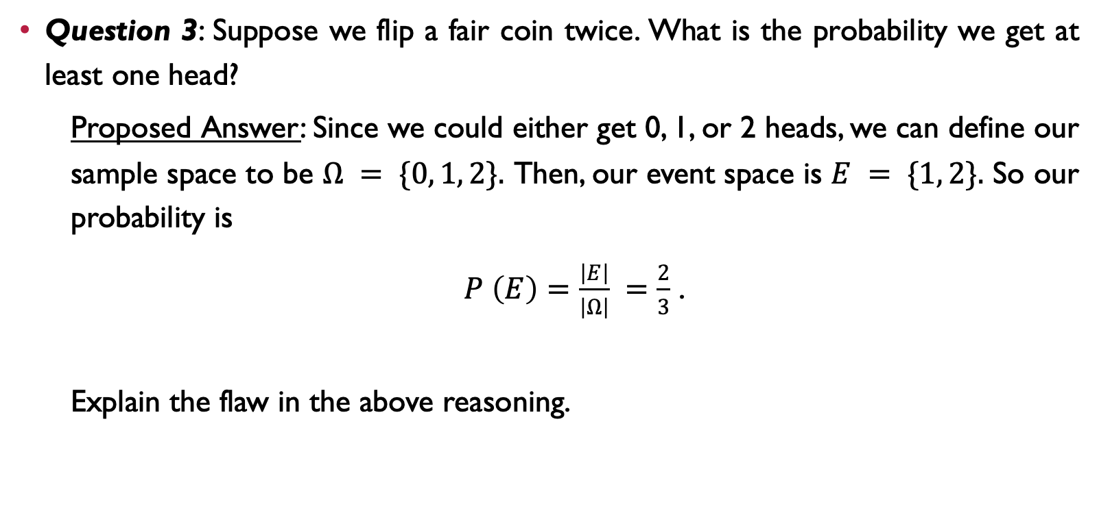
SAMPLE SPACEs HAVING EQUALLY LIKELY OUTCOMES
Question 3: Suppose we flip a fair coin twice. What is the probability we get at least one head?
Proposed Answer: Since we could either get 0, 1, or 2 heads, we can define our sample space to be $Ω = \{0, 1, 2\}.$ Then, our event space is $E = \{1, 2\}.$ So our probability is
$P \left(E\right)=\frac{\left|E\right|}{\left|Ω\right|} =\frac{2}{3}$ .
Explain the flaw in the above reasoning.

Slide 26
One more thing …

Slide 27


